Slide 1
Practice 1
Windows Programming Design

Slide 2
Practice 1- 1
Expense Tracker Program

Slide 3
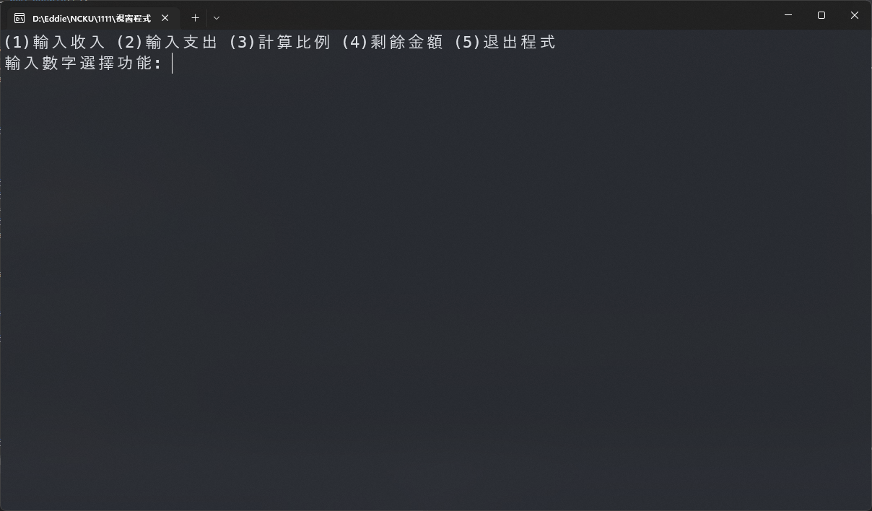
Expense Tracker Program
Create the following functions:
Enter income
Enter expense
Calculate the ratio
Balance
Leave the program
Enter the number to select a function

Slide 4
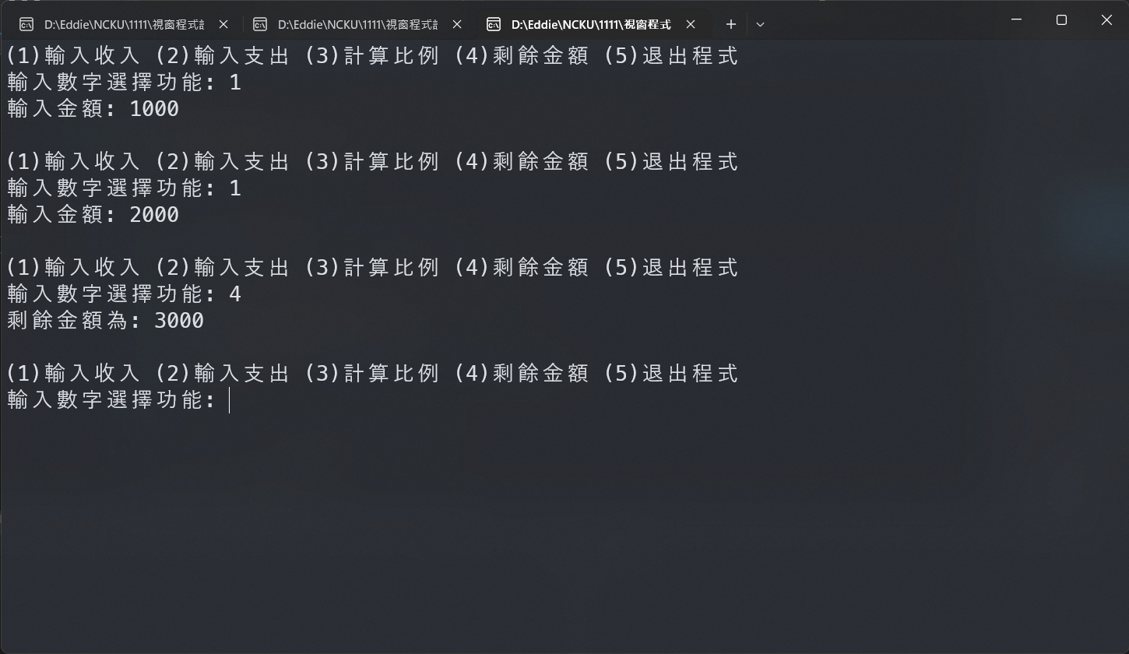
Enter Income
Ask the user to enter the amount
(Only positive integers could be entered)
Each entered income will accumulate

Slide 5
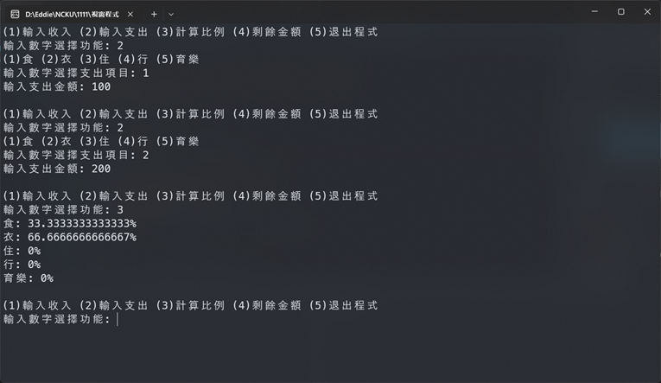
Enter Expense
The user selects expense item using numbers: food, clothing, accommodation, transportation, education with entertainment
(Only 1~5 will be entered)
And the expense amount will be entered
(Only a positive integer will be entered)

Slide 6
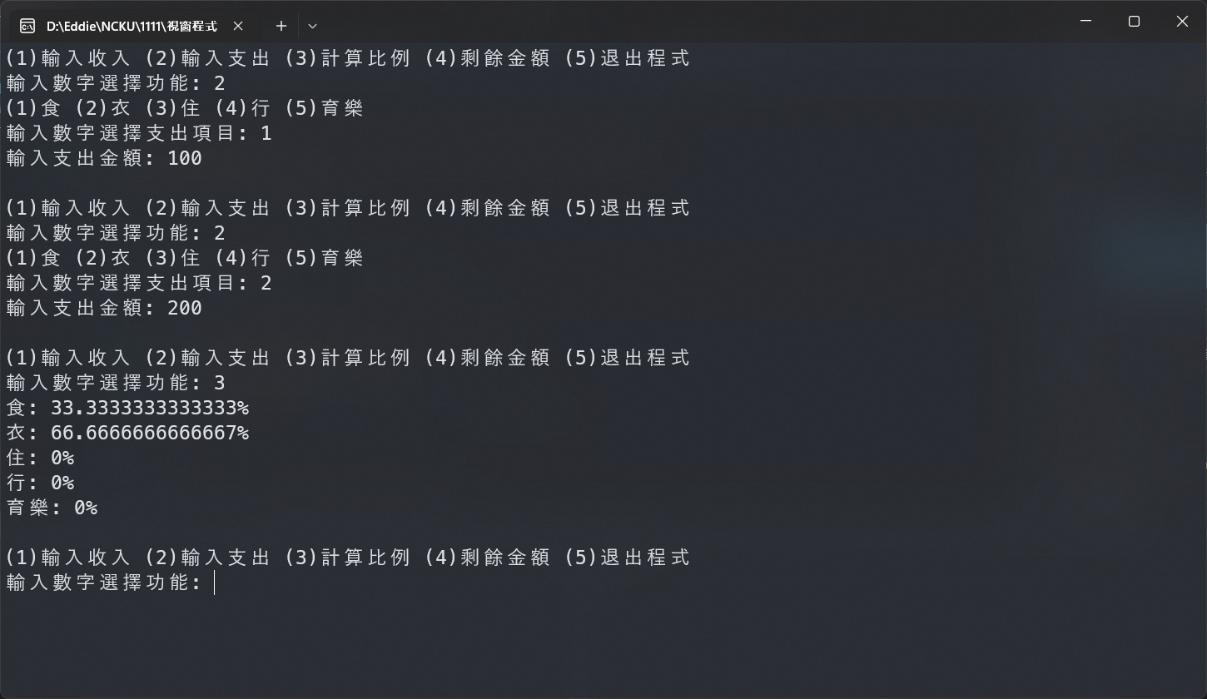
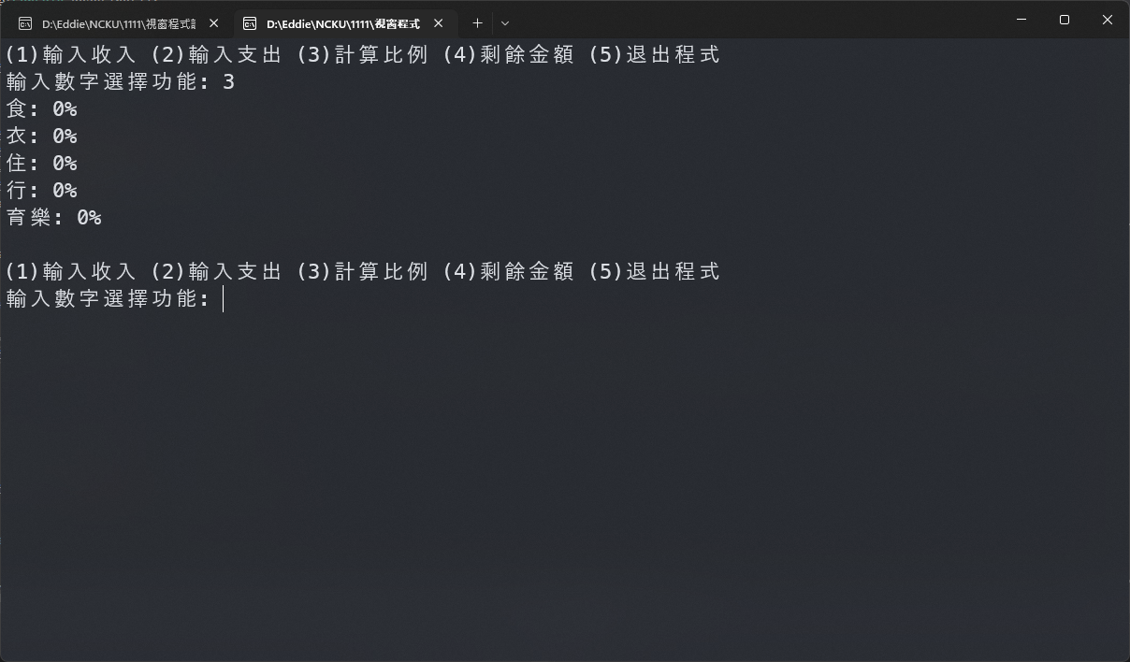
Calculate the Ratio
Output the percentage that each item accounts in the total expense
If the total expense is 0, each item is 0%

Slide 7
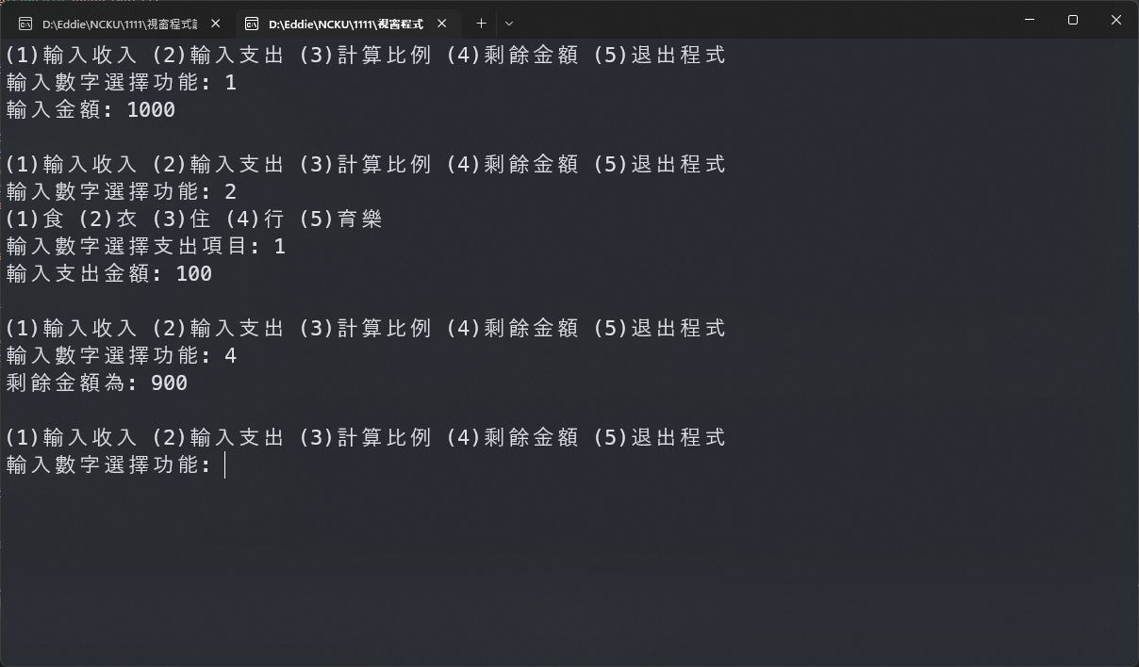
Balance
Output the current balance
(could be negative)

Slide 8
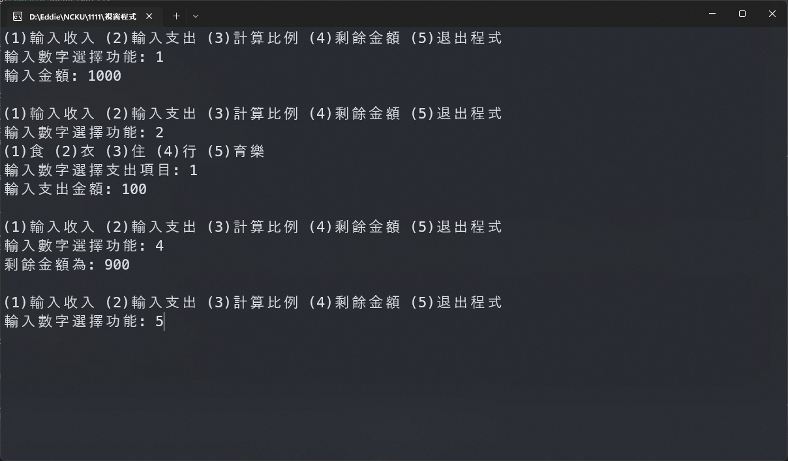
Leave the Program
The program must allow selecting different functions repeatedly.
When (5) is selected to leave the program, the program must end.

Slide 9
Practice 1 - 2
Expense Tracker Program

Slide 10
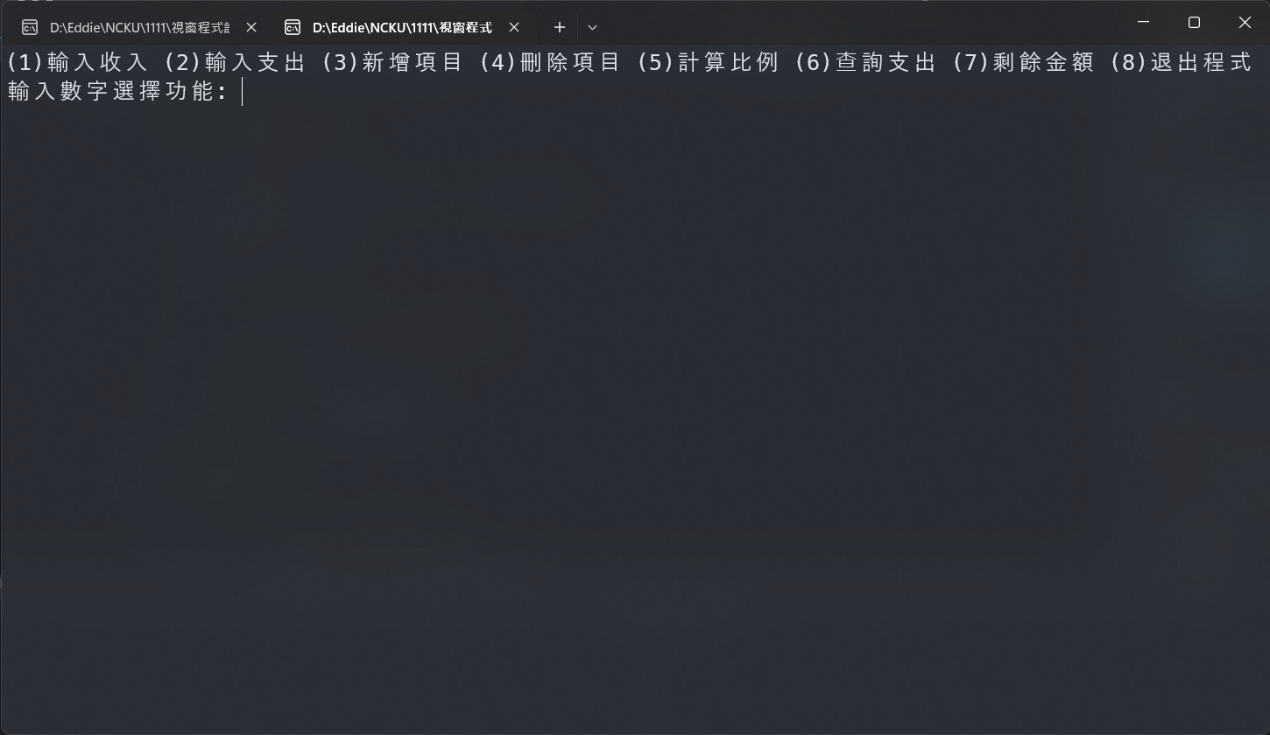
Expense Tracker Program
Extension of Practice 1 – 1, create the following functions:
Enter income
Enter expense
Add item
Delete item
Calculate the ratio
Search expense
Balance
Leave the program

Slide 11
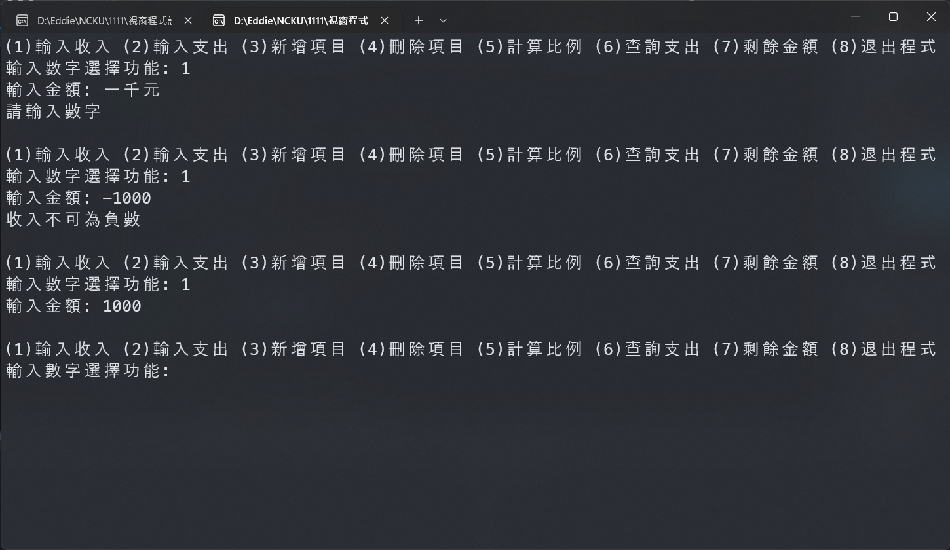
Enter Income
Ask the user to enter the amount. If the user enters a non-numeric character, show "Please enter a valid number“
When a negative number is entered, it should show “the income must not be negative”

Slide 12
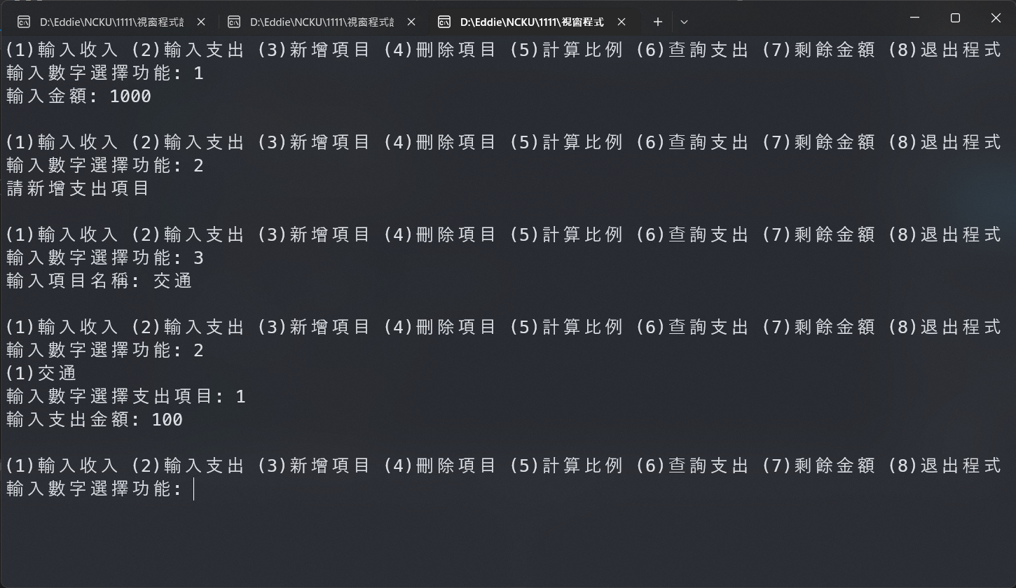
Enter Expense
When the user is selecting expense item using numbers, the items are not restricted to food, clothing, accommodation, transportation, education, and entertainment. Users should be able to add new items themselves.
(the number entered would not exceed the range)
When there is no expense item, show “please add an expense item”.

Slide 13
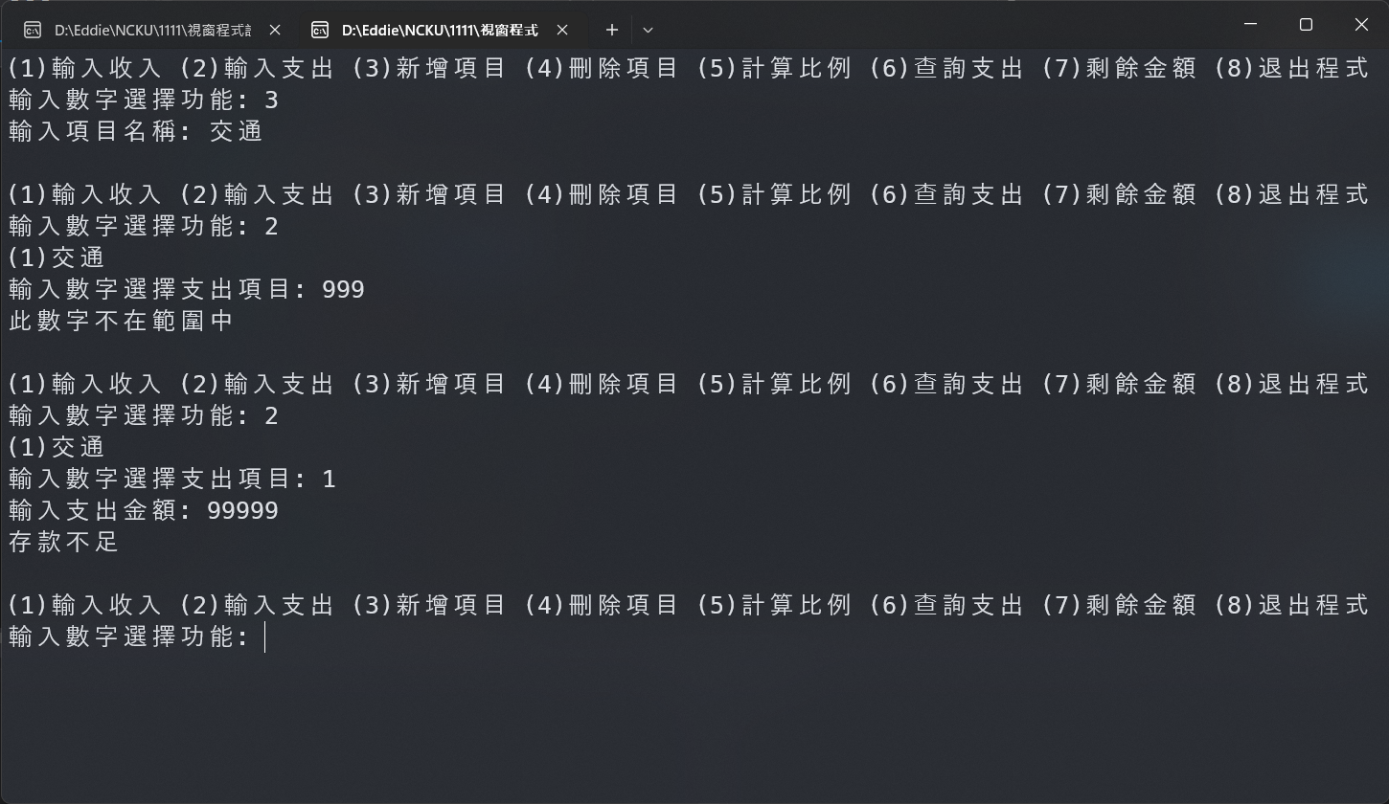
Enter Expense
If the expense is more than the income, show "Insufficient deposit“
If the entered number is not in the item range, show "This number is not within the range."

Slide 14
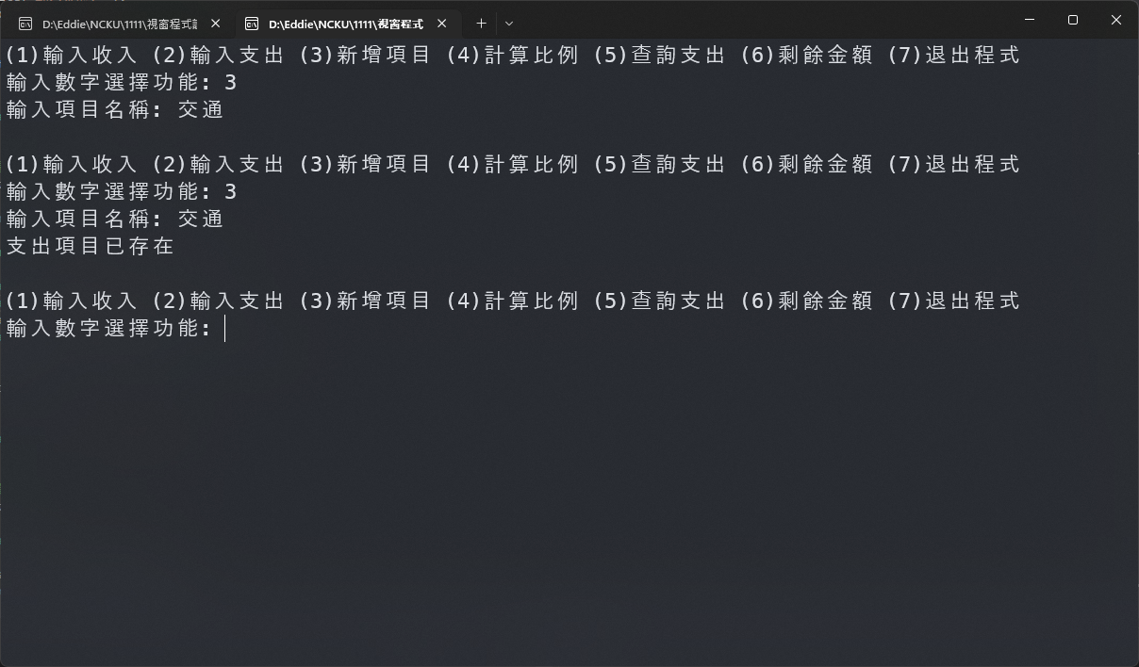
Add Item
Ask the user to enter item name to add new expense items.
When the expense item already exists, show “the expense item already exists”.

Slide 15
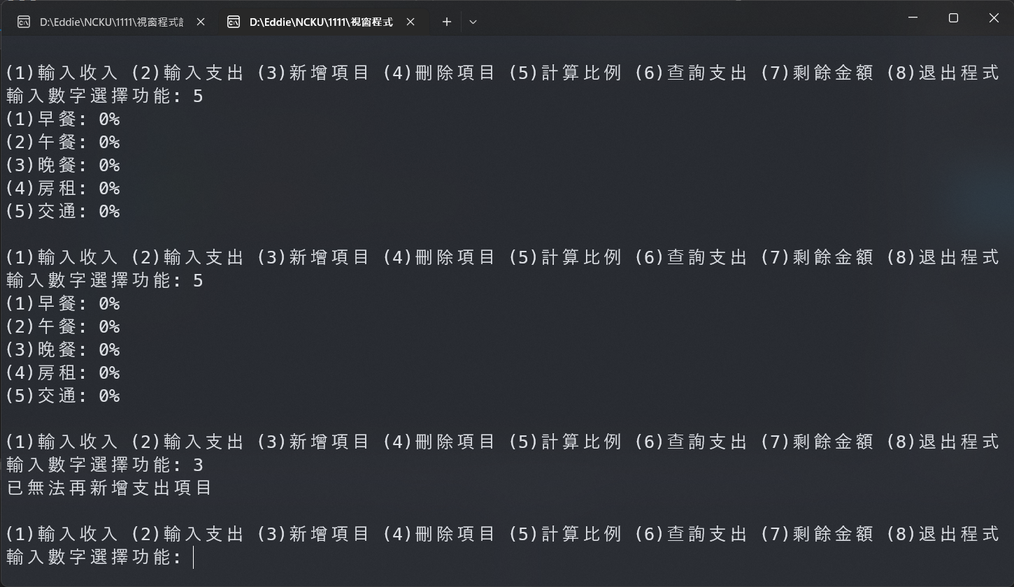
Add Item
The maximum number of items is 5.
When a 6th item is trying to be added, show “you can no longer add more expense items”

Slide 16
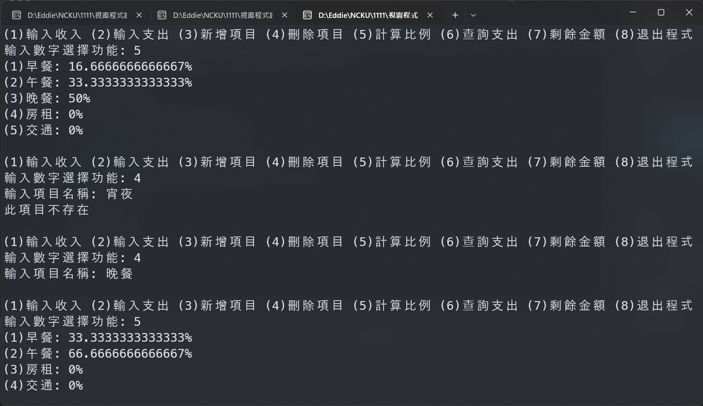
Delete item
Ask the user to enter the item name to delete existing expense items and delete the expense of that item.。
If the expense item does not exist, show "This item does not exist"

Slide 17
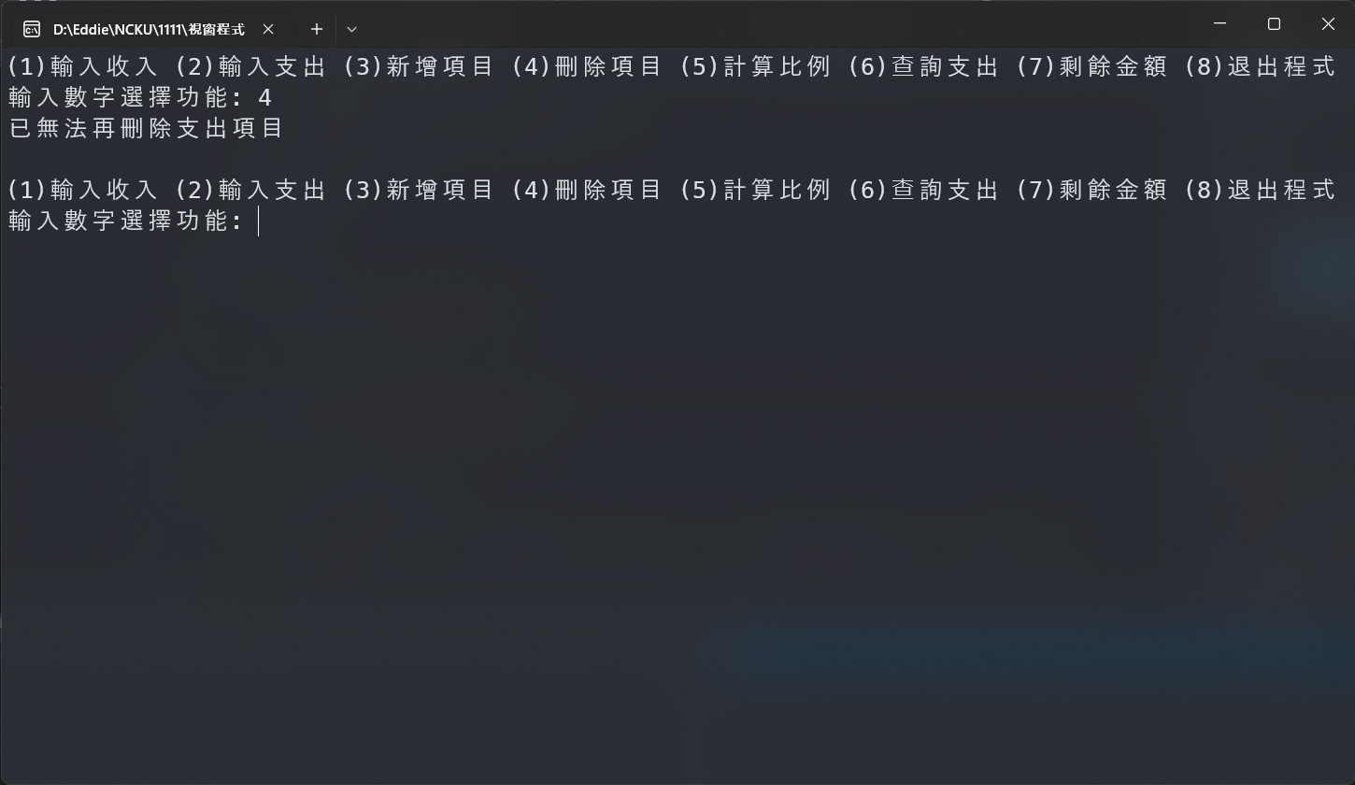
Delete item
If there is no expense item at the moment, show "Expenses can no longer be deleted"

Slide 18
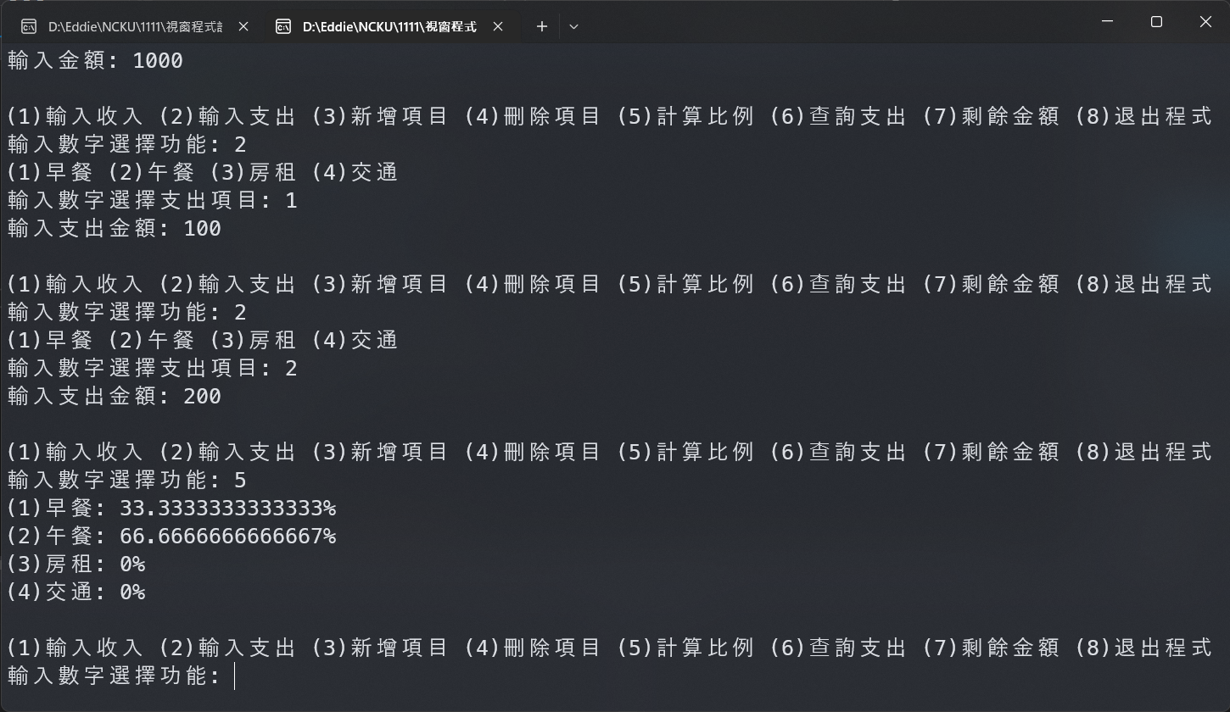
Calculate the Ratio
Output the percentage that each item accounts in the total expense

Slide 19
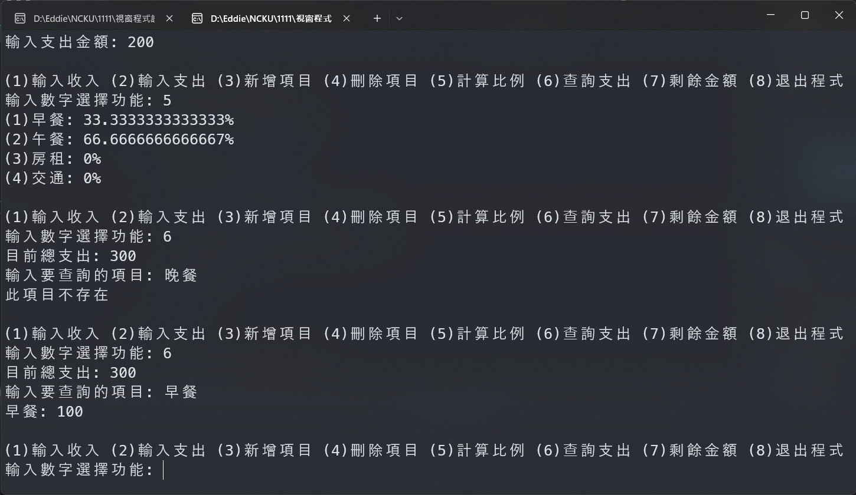
Search Expense
Output the current total expense.
After entering the item name, output the expense amount of the item.
If the item does not exist, show “this item does not exist”.

Slide 20
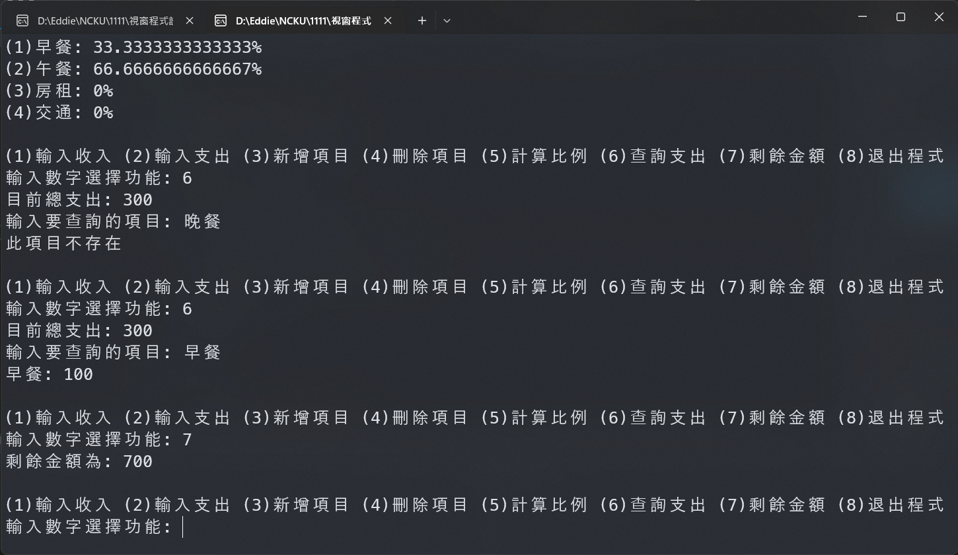
Balance
Output the current balance
(could be negative)

Slide 21
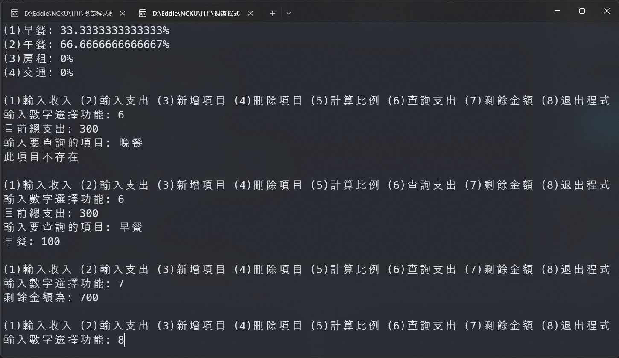
Leave the Program
The program must allow selecting different functions repeatedly.
When (8) is selected to leave the program, the program must end.

